Slide 1
Mobile-Commerce Development
Lesson
Assets and Shared Preferences
Lecturer:
Tran Duy Thanh, Phd
Nguyen Quang Phuc, Msc
Email: thanhtd@uel.edu.vn
Blog: https://tranduythanh.com
Phone: 0987773061

Slide 2
Lesson Objective
Students work with Assets as well
Students can Read data from Assets
Students can Read and write data by Shared Preference object

Slide 3
Outlines
Introduction to Assets in Android
How to retrieve data from Assets
Introducing Shared Preferences
Use Shared Preferences

Slide 4
1. Introduction to Assets in Android
assets is the folder containing input data files for the application: sounds, images, text, database files, etc. These files will not be compiled when the application is packaged.
Files in assets/ are not given resource IDs ➔ they can only be read using AssetManager.

Slide 5
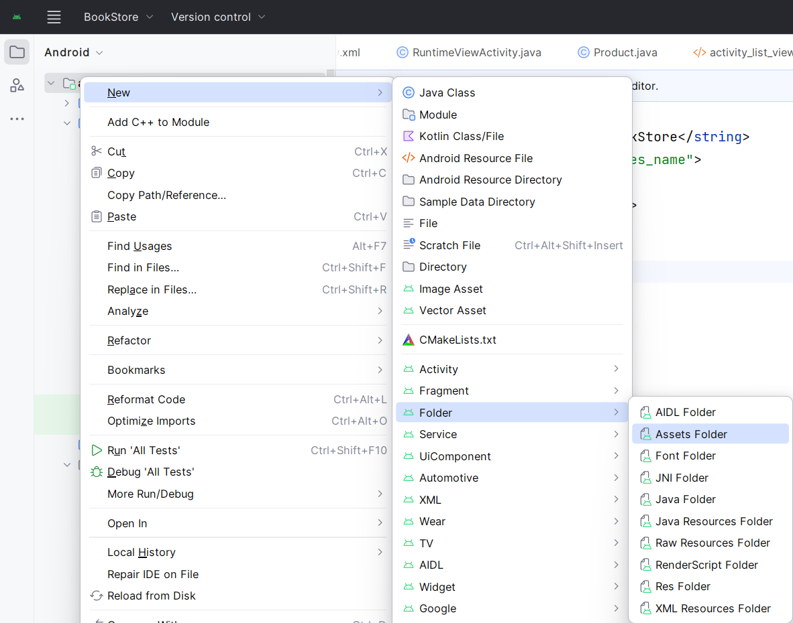
1. Introduction to Assets in Android
Create assets folder

Slide 6
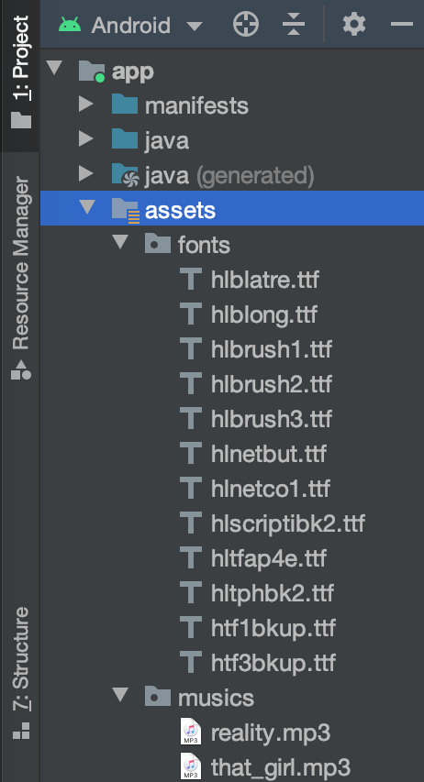
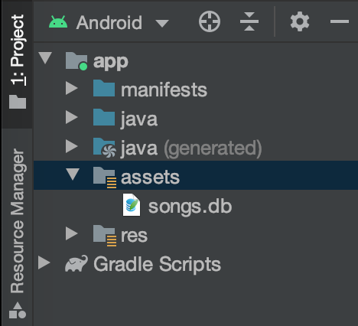
222
1. Introduction to Assets in Android
Create assets folder

Slide 7
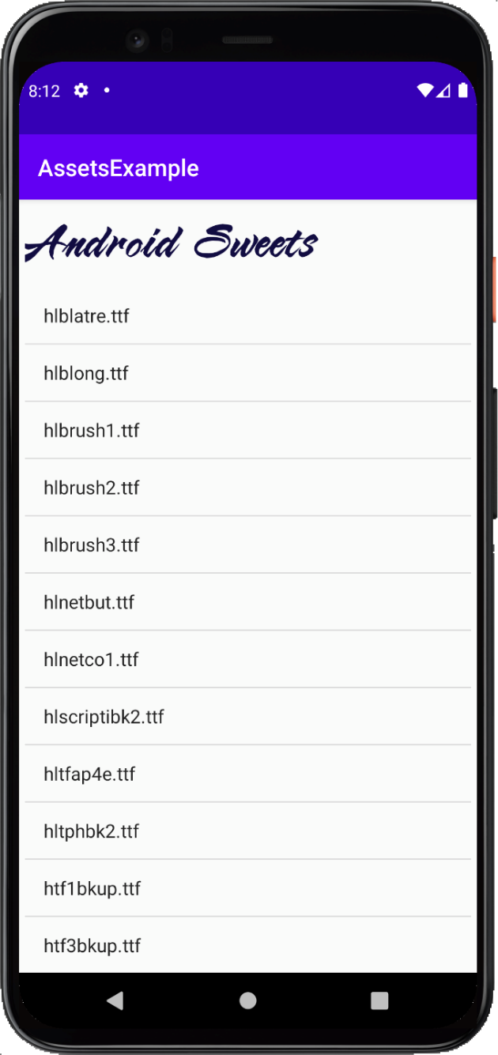
2. How to retrieve data from Assets
Example: Access Fonts

Slide 8
2. How to retrieve data from Assets
Example: Access Fonts
lvFonts = findViewById(R.id.lvFonts); fontAdapter = new ArrayAdapter<String>(MainActivity.this, android.R.layout.simple_list_item_1); lvFonts.setAdapter(fontAdapter); try{ AssetManager assetManager = getAssets(); String[] arrFonts = assetManager.list("fonts"); fontAdapter.addAll(arrFonts); }catch (Exception e){ Log.e("Error: ", e.toString()); }
Typeface typeface = Typeface.createFromAsset(getAssets(), "fonts/" + fontAdapter.getItem(i)); textContent.setTypeface(typeface);

Slide 9
2. How to retrieve data from Assets
Example: Access Audio
private void playAudio() { try{ AssetFileDescriptor assetFileDescriptor =
getAssets().openFd("musics/ting.mp3"); MediaPlayer mediaPlayer = new MediaPlayer(); mediaPlayer.setDataSource( assetFileDescriptor.getFileDescriptor(), assetFileDescriptor.getStartOffset(), assetFileDescriptor.getLength()); assetFileDescriptor.close(); mediaPlayer.prepare(); mediaPlayer.start(); }catch (Exception e){ Log.e("Error: " , e.toString()); } }

Slide 10
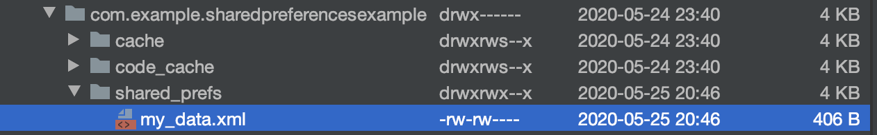
3. Introducing Shared Preferences
Shared Preferences allows storing application data in XML files.
Data is stored and retrieved in key-value pairs with data types such as: Boolean, Float, Int, Long, String.
Data is preserved even when the application is completely closed.

Slide 11
4. Use Shared Preferences
Save Data
Step 1: Create an instance Shared Preferences object
SharedPreferences preferences =
getSharedPreferences(PREFERENCES_NAME, MODE);
Step 2: Create Editor object from preferences edit() method
SharedPreferences.Editor editor = preferences.edit();
Step 3: Put data through put<Type> method
editor.putInt("int", 8); editor.putFloat("float", 6.8f); editor.putLong("long", 36); editor.putBoolean("boolean", true); editor.putString("string", “Android Sweets”);
Step 4: Save Shared Preferences via apply() or commit() method
editor.apply();

Slide 12
4. Use Shared Preferences
Access Data
The data retrieved with the get<Type> method depends on the data type:
get<Type>(Key, DefValue);
DefValue: is the default value returned when get<Type> cannot return the value corresponding to the input key.
For Example:
SharedPreferences preferences =
getSharedPreferences(PREFERENCES_NAME, MODE); int i = preferences.getInt("int", 0); float f = preferences.getFloat("float", 0.0f); long l = preferences.getLong("long", 0); boolean b = preferences.getBoolean("boolean", false); String s = preferences.getString("string", "");

Slide 13
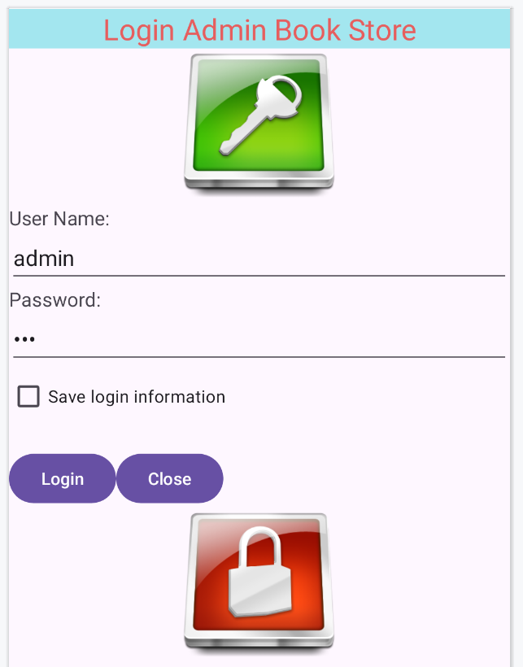
Exercise
Using Shared Preference to store login information

Slide 14
Discussions
Q1: Present the assets working
Q2: Present the shared preference working
Q3: How we save class object information by Shared Preference?

Slide 15
Next Lesson
SQLite
Content Provider

Slide 16
THANK YOU!

